Slide 1
Used Car Price Prediction
Group B
Week 14

Slide 2
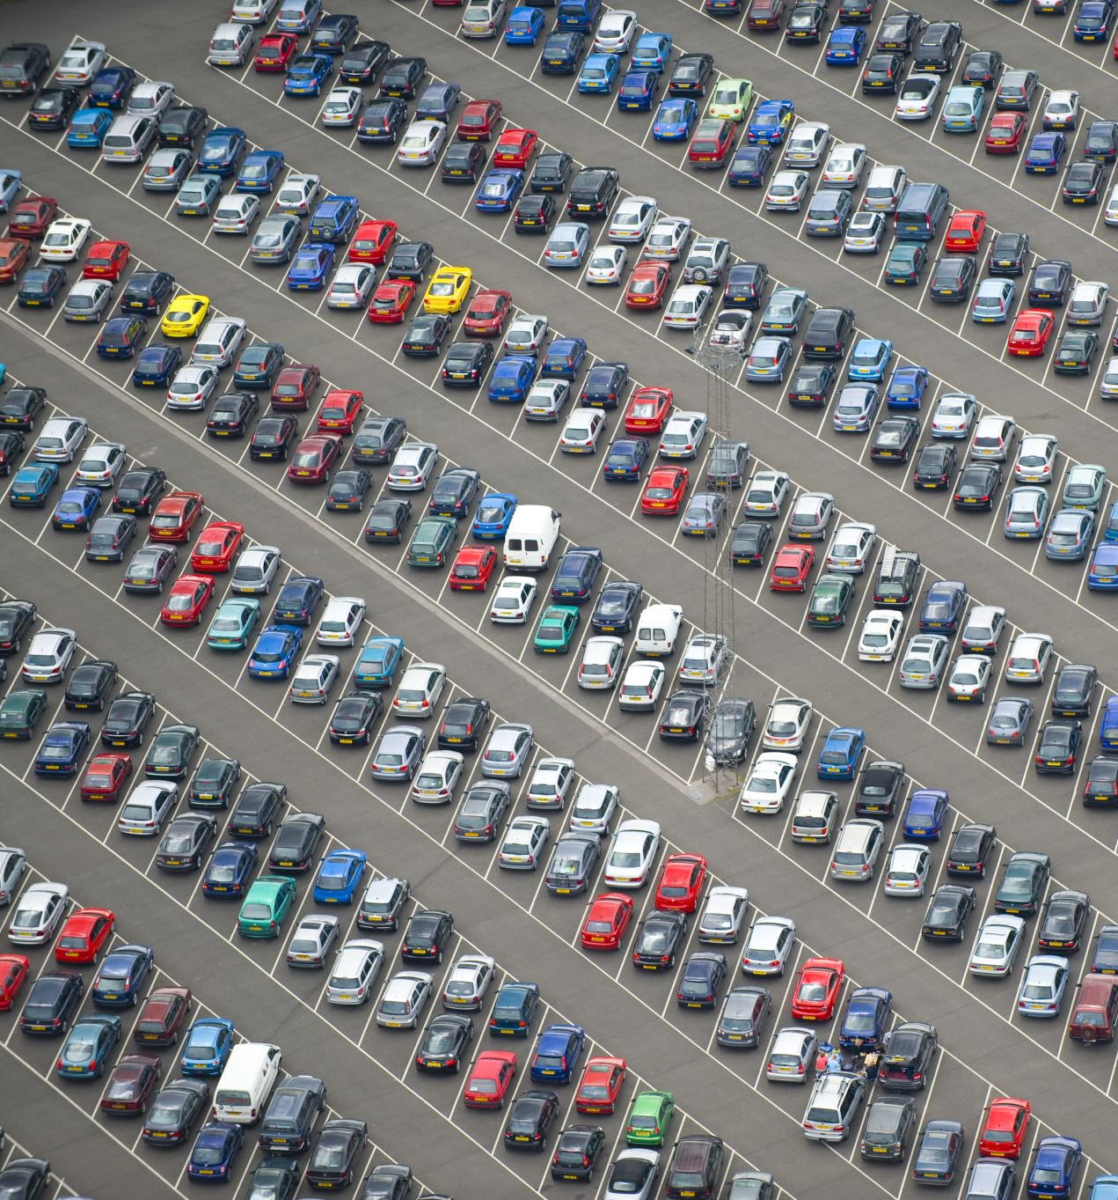
Previously,
Data exploration
Data visualization
Data cleaning
Correlation
Outlier handling
One hot encoding
Model Training
Getting insights
More Feature Engineering

Slide 3

Goal:
Model Tuning
Worked for better accuracy
Found alternative solutions to increase
the accuracy
Different models we tried:
Linear Regression
Support Vector Regression
Random Forest

Slide 4

How we achieved better accuracy?
Outlier handling: Engine size
Feature engineering:
Manufacturer
How to prevent data leakage?
Performing one hot encoding on
train and test split
b. Which enforce model to prevent
Data leakage

Slide 5
Perform different scaling techniques
Standard scalar
Min-max scalar
Standard scalar:
a. provide better flexibility to
with data

Slide 6
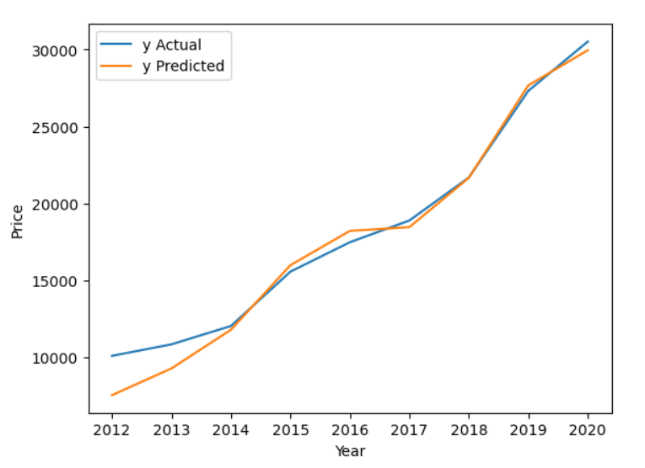

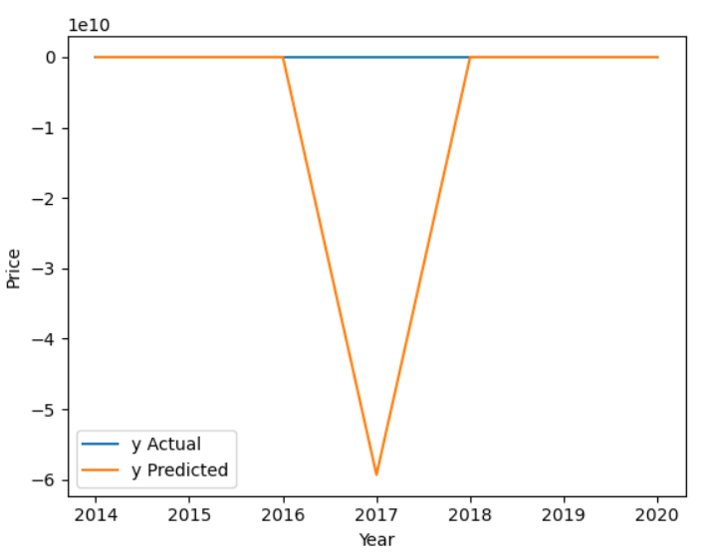
Evaluation
With Linear regression 150+ features
150+ features OMG!!!

Slide 7
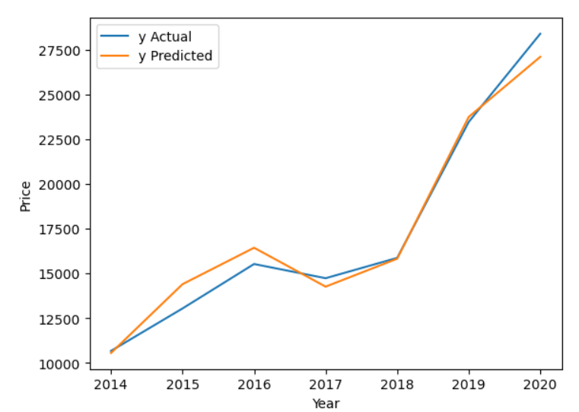
Evaluation
After removing feature(model)

Slide 8
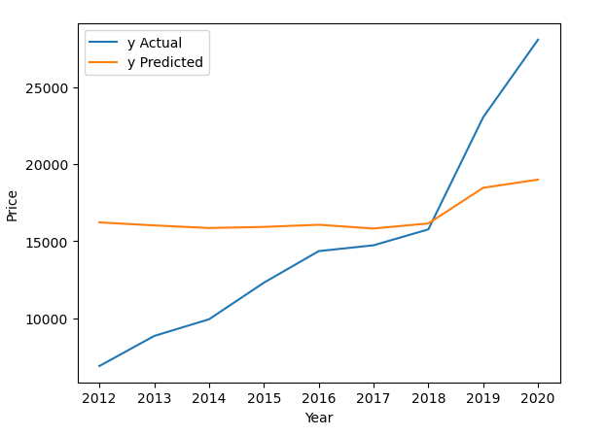
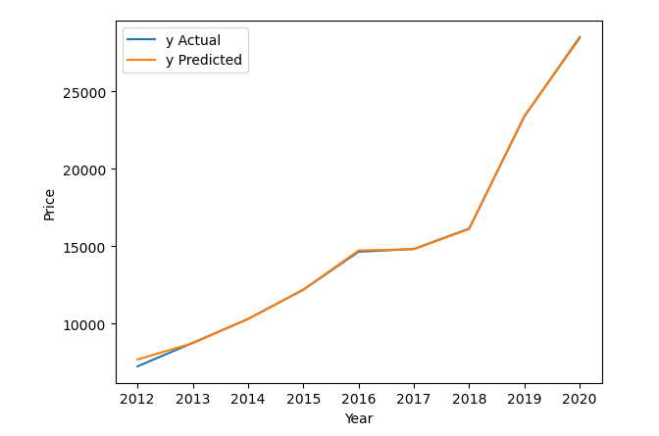
Evaluation
SVR
Random Forest

Slide 9
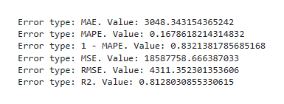
Our Best Model: Combine the data
Linear Regression

Slide 10
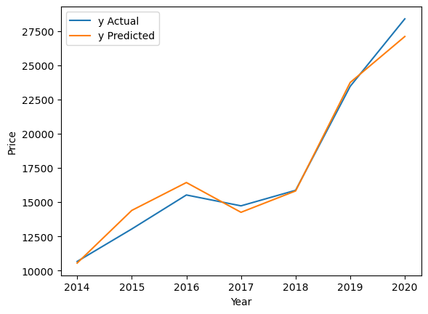
Our Best Model: Combine the data
Linear Regression

Slide 11
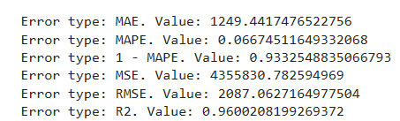
Our Best Model: Combine the data
Random forest

Slide 12
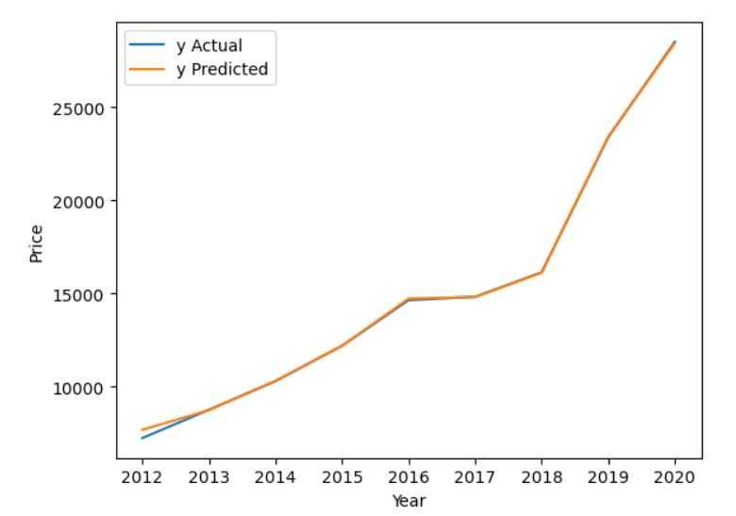
Our Best Model: Combine the data
Random forest

Slide 13
Conclusion
If you want to purchase used car
Reach out to us
Will provide you best price

Slide 14
Thank You

